Slide 1
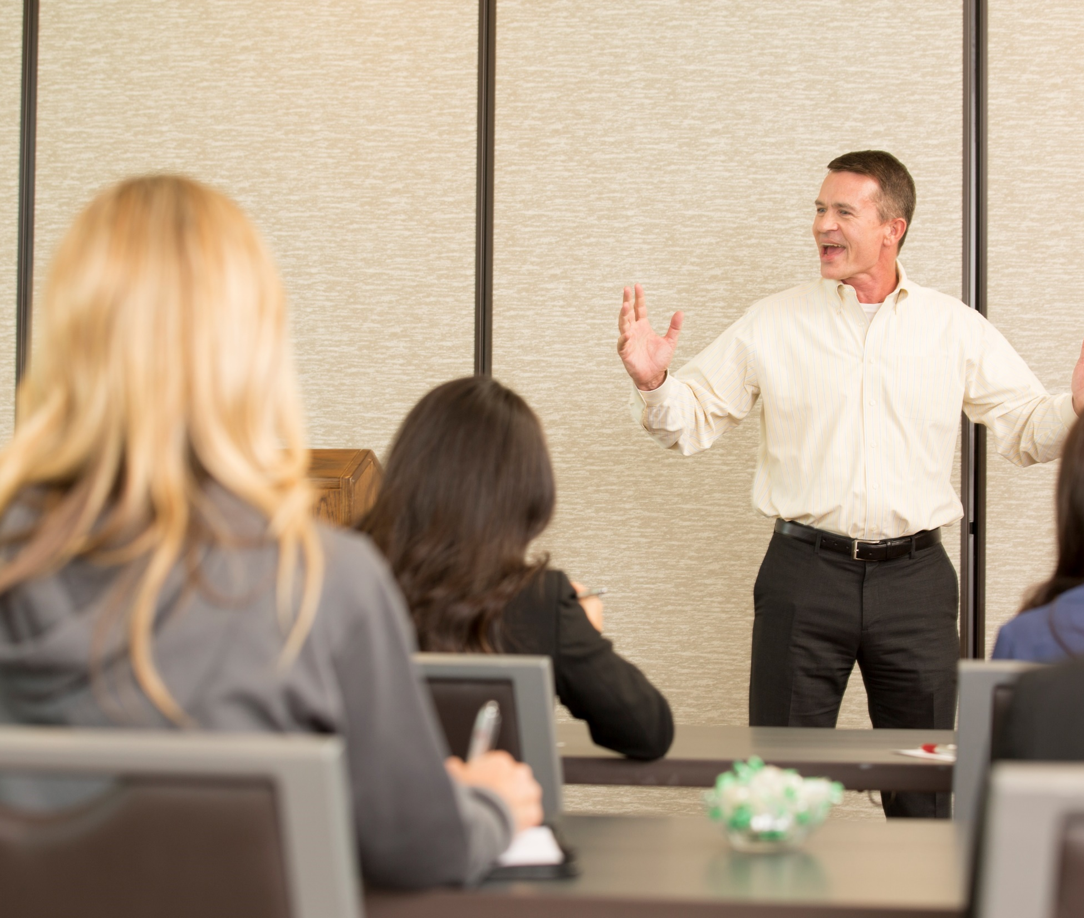
How to Train Judges and Staff for your Club Contests
District 66 Learning Institute
Notes:
Speech contests are an important part of the Toastmasters educational program. They provide an opportunity for Toastmasters to gain speaking experience, as well as an opportunity for other Toastmasters to learn by observing proficient speakers.
There are two keys to putting on a good contest: preparation and communication. Preparation involves making sure you have the right people and the right materials. Communication involves ensuring that all those involved understand their roles and responsibilities. The Chief Judge is important in the success of a contest. Their ability to work with everyone to ensure everything works well is important. The advice contained in this guide has been gleaned from the experience of conducting and attending numerous contests and observing what worked well and what didn’t.

Slide 2
agenda
Obligations
Requirements
The Contest
Notes:
The Chief Judge has an important role in the overall success of any contest. We will discuss this important role and the obligations the judges, ballot counters and timers have to Toastmasters International, the contestants, the audience and themselves. In addition, we will also talk about the Zoom Facilitator and the use of Breakout Rooms. These new roles and processes are important steps when conducting a contest in the virtual environment.

Slide 3
contest success
Planning
Preparation
Execution
Notes:
Success takes planning, preparation and of course execution.
Tonight, I will discuss with you what the role of the chief judge, voting judges, tie-breaking judge, timers and ballot counters are during the planning, preparation and execution phases of a contest. In January, the District 66 Learning Institute will host a Town Hall style forum with past successful chief and voting judges. After you have read the rulebook and begun your planning and preparation, if you still have questions, please join us for this event. Check out the Event Calendar at tmdistrict66.org for details.

Slide 4
contest officials
contest chairperson
chief judge
Notes:
The two lead officials for any contest are the chairperson and the chief judge. As the chief judge, once appointed by the chairperson, the chief judge partners with them during all three phases. While the rulebook cites the chairperson and contest master are the same role, many clubs, areas, divisions and districts choose to separate the role of the organizer or chairperson from the emcee portion during the contest. It is up to your club to determine whether that makes sense for you. But, be very clear to the judges and contestants, who will be the “go to” for issues while handling challenges or protests on contest day.
The Chief Judge works with the Contest Chairperson to find/appoint Voting Judges, a Tie-Breaking Judge, Ballot Counters, and Timers.
Both have responsibilities to those involved. To the contestants, a well-run contest with a professional performance by the judges and other contest officials
To Toastmasters International: Adhere to the rules
To the audience: Again, a well-run contest… that is entertaining.
To themselves: Ensure that the right person moves forward to the area contest

Slide 5
chief judge or judge
Qualities
Experienced
Fair
Requirements
Recruit judges and contest officials
Speech Contest Rulebook
Notes:
There are two essential qualities of a chief judge
Experienced, the role of the chief judge is central to the success of the contest. When choosing a chief judge, you not only want it to be someone who has participated in the other judge roles but it is suggested that they should have also served as a timer and ballot counter in the past as well. Having fulfilled these roles, contributes to their understanding when briefing the contest officials and assisting them during the contests.
And a chief judge must be fair: impartial and not prejudice. And able to evaluate on the criteria and not by emotions.
Depending on the specific contest for which they are serving, the requirements for eligibility may be different.
To be a chief judge, voting judge, or tiebreaking judge at a club speech contest, you must be a paid member. That is it. Don’t get it confused with the other levels.
[If asked: In order to move on and fulfill any of these roles at an Area, Division, or District contest, you must also: a) be a paid member for a minimum of six (6) months; b) have completed a minimum of six (6) speech projects in Competent Communication or earned certificates of completion in Levels 1 and 2 of any path in the Toastmasters Pathways learning experience]
At all levels, the judges must be physically present at the contest for which you are serving. Of course, the definition of physically present has been modified to mean actively in the Zoom meeting – Judges cannot review a recording to fulfill this role.
The chief judge handles the supplies to include ballots, timing sheets and results worksheets; briefs the judges, timers and ballot counters ensuring that all know their responsibilities and how to fulfill them appropriately.
The voting judges of which there should be no fewer than 5, will use the judge’s ballot worksheet to “score” the contestants then at the bottom in the portion presented to the ballot counters, enter the names of the first, second and third place finishers. No ballot will be considered valid without the clear name and signature of the voting judge. We understand that smaller clubs may not have the members to field 5 judges as well as all the other roles. Reach out to other clubs and ask for help.
The tie-breaking judge of which there is just one (above and beyond the other 5), will use the judge’s ballot specified for them, scoring just as the voting judges. However, when entering their results, they are required to put all contestants in order of finish from 1 to x. This ballot is only used if the results of the voting judges ends in a tie.
Encourage all speech contest officials, especially judges to:
View the online Speech Contest training at www.toastmasters.org
Read and become familiar with the Speech Contest Rulebook

Slide 6
Review protest procedures
Determine Ballot Collection
Works with Zoom Facilitator
Breakout Rooms
Dry Runs
before the contest
Notes:
Now that we know what the judges are responsible for…With virtual contests, this year more than before, there is lots to do before the contest.
Before the Contest, The Chief Judge
Review protest procedures, confirm that the contest chairperson will receive protests (if using a contest master), and ensure all are aware of the process
Determine method of receiving ballots – do not use chat (there have been instances, during contest visited by me, where “private” was accidentally not used and everyone saw the chat. As I discussed before, have them emailed or texted to the chief judge who will share them with the ballot counters in the Zoom breakout room. This ensures we see the actual results documented by the judge and the signatures as noted in the rulebook.
Work with Zoom Facilitator to schedule and determine how breakout rooms and the dry run with be handled. The dry run should be scheduled a day or two before the contest. All briefings and technical issues with sound/audio for contestants as well as briefings and procedures for using the breakout rooms and handling ballots with the counters and timing reports with the timers.
Read the Speech Contest Rulebook
Select the Judges (5+), Ballot Counters(2), and Timers (2)
Verify eligibility of Voting Judges and Tiebreaking Judge and collects Judge’s Certification of Eligibility and Code of Ethics (form 1170) from each judge during Dry Run
Downloads all relevant documents from the D66 website/ TI website to team members
Make a File Containing: - Chief Judge briefing script(s) - Voting Judges’ ballots - Tiebreaking judge ballot - Judges eligibility certificate - Tally and timer sheets - Result announcement and reporting forms
Before the Dry Run and again before the Contest, the Chief Judge:
Ensure zoom master has checked audio, space requirements, lighting, recordings, timer identification
Ensure Breakout rooms are established for all briefings. All participants need to understand how to get in and out of these rooms
Conduct Dry Run briefings. During the dry runs all briefings will be conducted. During these briefings, the Chief Judge will ensure everyone is qualified for their role.
The Chief judge will determine what method is used to obtain the votes from the judge and ballot counters.
Discuss the protest procedure with the judges

Slide 7
ballot counters
Responsibilities
Contestants
Toastmasters International
Audience
Themselves
Notes:
The basic responsibilities of the ballot counters are to collect and then impartially count the ballots completed by the judges. It is essential that the innerworkings of this process are not discussed and all remnants of the information used to reach the final results are destroyed and never shared.
For District 66 and your virtual/Zoom contest, we recommend that an image of the signed paper ballots are emailed or texted from the judges to the Chief Judge. Once the chief judge, ballot counters and SAA have been moved to a breakout room, the chief judge can display the ballots one by one to the counters via a screen share. The rest of the process is basically the same as if they were in a physical room reviewing and counting. Once results have been completed. The Chief Judge, as they would have in a physical room will complete the results forms and hold them until it is time to announce the winner.
The contestants must have confidence that the results were fairly determined. The professional handling of the ballots and the results is key to that belief.
Toastmasters International is counting on ballot counters to be fair and adhere to the rules regarding legibility, signature, etc. This means, you must know the rules. Please review the rulebook.
The audience is full of club members, friends and family. They all expect professional behavior from contest officials.
As with any role we fill, we want to be proud of ourselves and how we handled it. Make yourselves proud. Double and triple check your math and each others.

Slide 8
Responsibilities
Contestants
Toastmasters International
Audience
Themselves
timers
Notes:
Timers are responsible for (1) timing the speeches and providing indicators to the speakers while doing so and (2) reporting the timing results to the Chief Judge. The Chief Judge actually makes the determination of disqualification based on the timers’ report. Make sure that the report is clear and that all results are legible.
While providing support to the Contestants remember, they are counting on you to guide them so they do not run over time. Stay focused. A key to your responsibilities is when to start the timer. The timer must be started at the first indication that the speaker is beginning whether it is visual or verbal.
For example, at a live contest, a contestant walking to the stage in character, in chat, when do you start the timer? As soon as they go into character is the right answer. They are communicating with the audience at that moment, so their presentation has begun.
Another, from a World Champion who almost went over time. She clasped her hands, made a giggle-like sound and looked around when entering the stage. Then moved forward, positioned herself and began her speech. The timer should, and seemed to do this correctly, start the timer when she made that first sound. She came within 1 sec of 7 minutes and 30 seconds. I am sure that is not how she practiced it. This is also true in Zoom. At the first gesture or sound that is an interaction with the audience, the timing starts.
Timers complete the timing report and text or email it to the Chief Judge. The Chief Judge reviews and determines any disqualifications while the ballots are being counted. Once counted, if there is a disqualification, the chief judge shares that information, and that contestant is removed from the results.
Toastmasters International expects that kind of accuracy for the timing.
The audience, should not know if or who is within or outside their time. Do not make any indications. Just note the times on the report for the chief judge.
As with all roles, again make yourselves proud. Keep the results to yourself.

Slide 9
Responsibilities
Contestants
Toastmasters International
Audience
Themselves
zoom facilitator
Notes:
The newest member of the club contest team is the zoom facilitator. In January, our District Zoom Master, Earl Reyes will conduct two offerings of training specifically around facilitating contests. Each club will need a zoom facilitator for their contest. Please determine who your facilitator will be and ensure they attend this training. See the event calendar and ProClass for details and registration.
The Zoom facilitator along with the contest chairperson should work with their Division Director if they need a Zoom account for their contests. Once the account has been determined, the facilitator can schedule the “meeting”/contest and begin the preparation process. The link should be presented to all club members, contest officials, and guests that will be attending the contest.
Before the dry run, the Zoom facilitator will establish the breakout rooms and add the appropriate contest officials so that they will automatically be moved to tally results.
System checks: Audio/Visual/Background Checks
Pinning to Contestants
Renaming: Contestants use their presentation order followed by their first and last names only,
Ensure judges are renamed as Judge and remain off camera at all times when in the main contest meeting
During the dry run, the Zoom facilitator can assist contestants with issues regarding use of Zoom, adjustments to help resolve audio or video issues, etc.
Toastmasters International is counting on those serving in this new role to assist the entire contest team in smoothly acclimating to a virtual environment.
The facilitator should announce to the audience, best practices for viewing the contest and help them set their computers appropriately.
And, as we have been saying, we always want to make ourselves proud of how we handled a role.

Slide 10
breakout rooms
Participants arrival
Scorecard Process
System checks
Renaming
Notes:
Speaking of the breakout rooms; what specifically will happen within them:
Participant arrival: Ensure all contestants arrive 45 minutes before and are briefed by the Contest Chairperson regarding: Naming, Audio, Lighting, Area , Timing, Speaking Order
Ensure all judges arrive 30 minutes before and are briefed on the following: Naming, Voting, Anonymity, how the breakout rooms will work during the contest
Participant Briefings: Conduct briefings to include the review of all procedures regarding handling of results and submission of forms.
Collect participant eligibility forms, if not emailed beforehand

Slide 11
Why?
Equipment Checks
Eligibility Review
Area Check
Briefings
Practice
Renaming
dry run
Notes:
This will be our first time hosting a virtual contest and technology can sometimes be an issue on the best of days. A dry run for the contest officials and the contestants is key to a successful contest day. Do it a day or two before. Contest day is not the time to resolve issues. Give your team time to iron things out.
Just as they do on contest day, all Participants must arrive 30-45 minutes prior to the start of the dry run.
Equipment check: Makes sure the equipment and connectivity is working
Breakout Rooms: Briefs contestants and judge committee
Complete & Turn in Eligibility Forms
Area Check (lighting, sound, movement, background)
Briefings: Judge, Timer, Ballot Counters are briefed in one room Contestants are briefed in another virtual room
Practice: Contestants are encouraged to practice on camera and will be provided a time to do so. This will ensure you are heard and seen
Judge renaming: Ensures anonymity

Slide 12
Review protest procedures
Review Ballot Collection procedures
Review use of breakout rooms
Reviews contents of materials packet
briefings
Notes:
Packets to judges and other officials will be emailed prior to the dry run. Have them available for the briefings. For judges, please complete the eligibility forms and return them via email prior to the dry run.
- Voting Judges’ ballots - Tiebreaking judge ballot - Judges eligibility certificate - Tally and timer sheets - Result announcement and reporting forms
Brief Ballot Counters in the use of the Counter’s Tally Sheet and how you as a club Chief Judge will be accepting ballots from judges. Provide your email or cell phone number (for text).
3 points for 1st place
2 points for 2nd place
1 point for 3rd place
Record rankings provided by each judge
Tiebreaking Judge’s ballot
Only used to break a tie
Timers are briefed in the use and submission of the timer’s results sheet. Again, provide your email or cell phone number.
Contestants and SAA are briefed by the Contest Chairperson in a separate breakout room.

Slide 13
contest day
Ensure Judge’s Presence
Collect Timer Sheet
Collect Judge’s Ballots
Tabulate Results
Give Result to Contest Chairperson
Notes:
Ensure that all judges are present in the breakout room and have been briefed.
Ensure that decorum is maintained during contest.
Collect the Timers record sheet
Collect the Tiebreaking Judge’s ballot
Tabulate the winners with the help of Ballot counters
Address protests
Give result to Contest Chairperson (if an emcee or Contest Master is used, the chairperson can forward the results for announcement)

Slide 14
after the contest
Complete Form 1182
Deliver forms to Contest Chairperson
Keep Contestant Placement List
Notes:
Complete Notification of Contest Winner (form 1182)
Deliver Notification of Contest Winner form to your contest chairperson for submission to the area director.
Keep a list showing placement of all contestants in case the first place winner is unable to compete at the next level and a replacement is needed.
This new world of virtual contests has put a strain on everyone. Remember to recognize your team and show appreciation for their support and participation.

Slide 15
summary
Obligations
Requirements
The Contest
Notes:
Recap: The Judges and specifically the Chief Judge are important roles in any contest. They ensure the success of the contest, the Chief Judge solicit the help of Judges, Ballot Counters, timers, and a Zoom Master. Collectively, this team plays crucial roles. In addition to the team, the Chief Judge is responsible for the eligibility of all participants and validity and fairness of the results.
I will say this one more time, read the rulebook, highlight pertinent areas relating specifically to the contests being held this spring. Your team, Toastmasters International, District 66 and the contestants and their guests are counting on you. You don’t have to memorize all of it, just where specific information is located to quickly access it when needed.

Slide 16
questions?
Notes:
Does anyone have any questions on today’s presentation?

Slide 17
thank you!
[instructor name here]
email address here
phone number here

