Slide 1
Zoom for Speech Contests
Earl R. Reyes, DL4
11 January 2021

Slide 2
Agenda
Introduction
Zoom roles
Configure meeting settings
Schedule/Start a meeting
Manage meeting participants
Manage meetings
Breakout rooms
Questions

Slide 3
Agenda
Introduction
Zoom roles
Configure meeting settings
Schedule/Start a meeting
Manage meeting participants
Manage meetings
Breakout rooms
Questions

Slide 4
Introduction
Zoom skills
Paid account
Practice!
Dry run

Slide 5
Agenda
Introduction
Zoom roles
Configure meeting settings
Schedule/Start a meeting
Manage meeting participants
Manage meetings
Breakout rooms
Questions

Slide 6
Zoom Roles
Participant
Host
Host
Alternative host
Co-Host

Slide 7
Zoom Roles – Host
Host
Schedules meeting
Full permissions
Only 1
Alternative host
Cannot create polls *
Either Host or Alternative Host, not both
Co-Host
Cannot start/end meeting
Cannot manage breakout rooms
Cannot create polls *

Slide 8
Actions – Co-Host
Admit participants
Assist participants
Take attendance
Introduce the presenter
Mute/unmute participants
Stop participant video
Rename participants
Remove participants
Start/stop recording **
Save chat ***

Slide 9
Actions – Host/Alternative Host
Start/end meeting
Create breakout rooms
Assign participants to breakout rooms

Slide 10
Agenda
Introduction
Zoom roles
Configure meeting settings
Schedule/Start a meeting
Manage meeting participants
Manage meetings
Breakout rooms
Questions

Slide 11
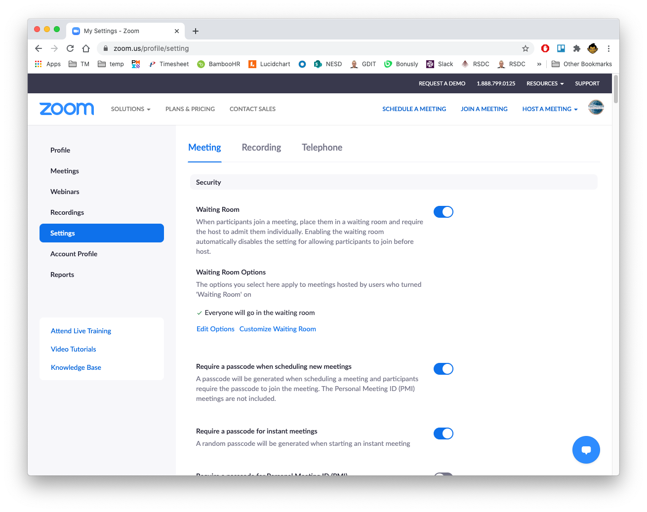
Settings

Slide 12
Settings - Meeting

Slide 13
Settings - Meeting
Security
Waiting Room
Require a passcode when scheduling new meetings
In Meeting (Basic)
Chat
File transfer
Co-host
Screen sharing
Allow participants to rename themselves
Virtual background
In Meeting (Advanced)
Breakout room

Slide 14
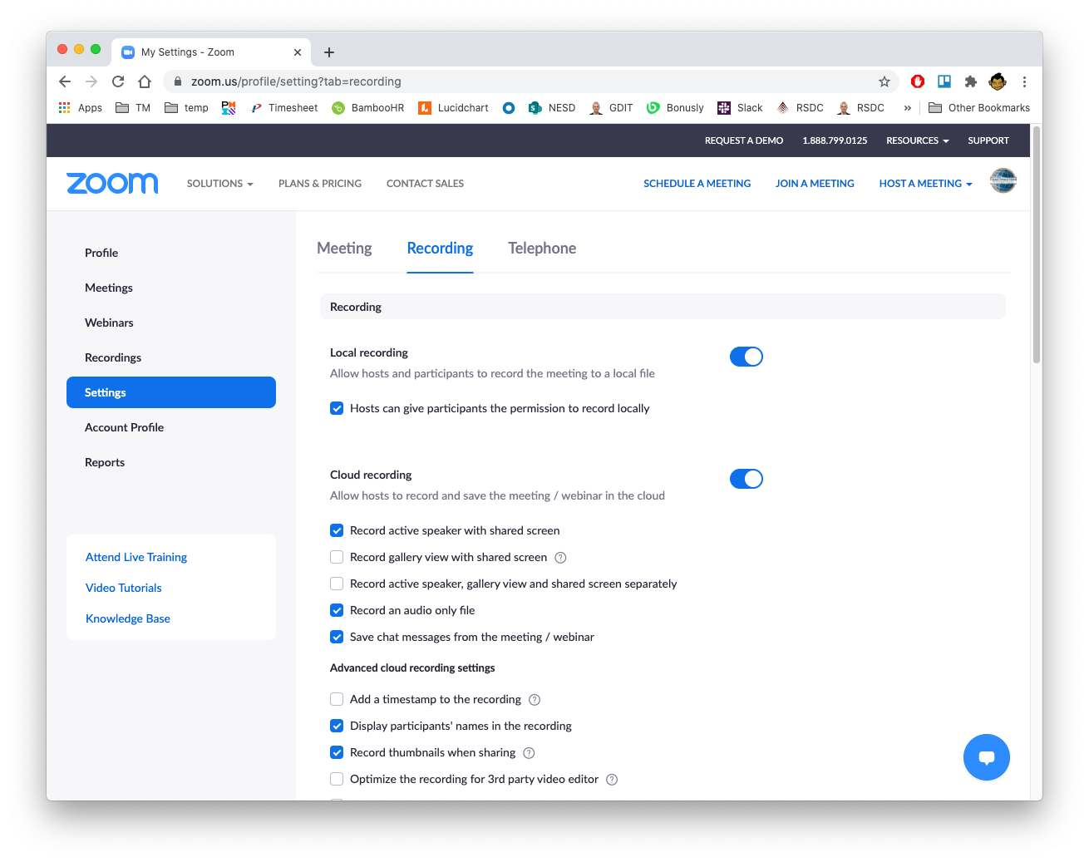
Meeting Settings

Slide 15
Settings - Recording
Cloud recording
Record active speaker with shared screen
Save chat messages from the meeting/webinar

Slide 16
Agenda
Introduction
Zoom roles
Configure meeting settings
Schedule/Start a meeting
Manage meeting participants
Manage meetings
Breakout rooms
Questions

Slide 17
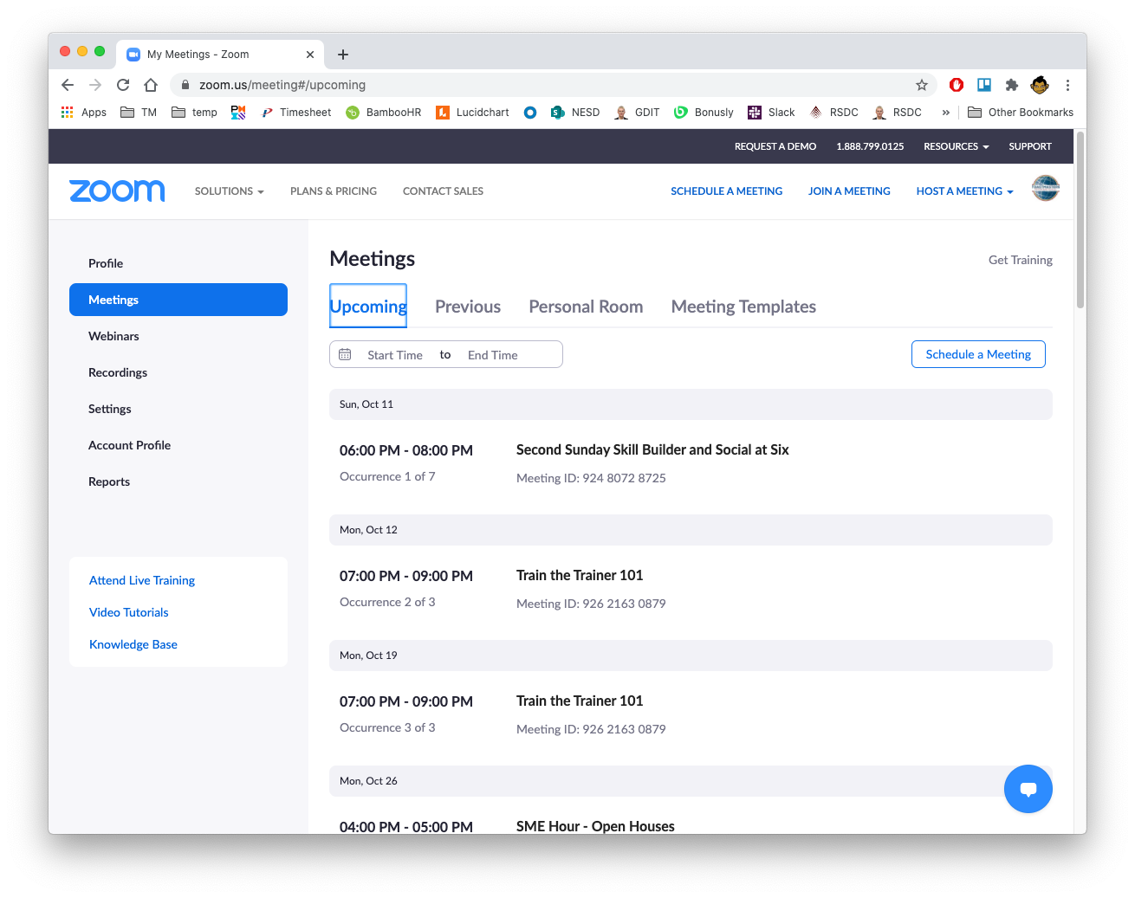
Schedule a Meeting

Slide 18
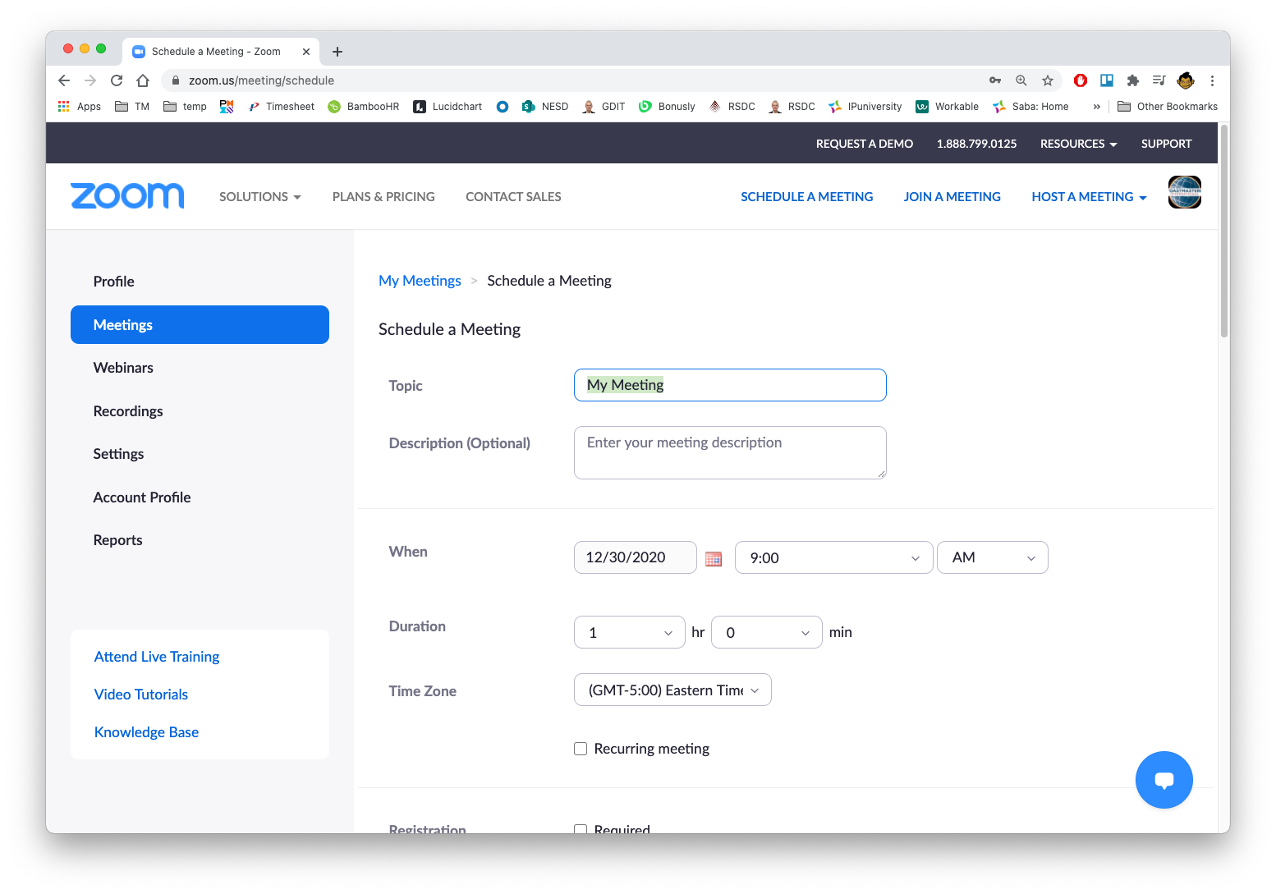
Schedule a Meeting

Slide 19
Schedule a Meeting

Slide 20
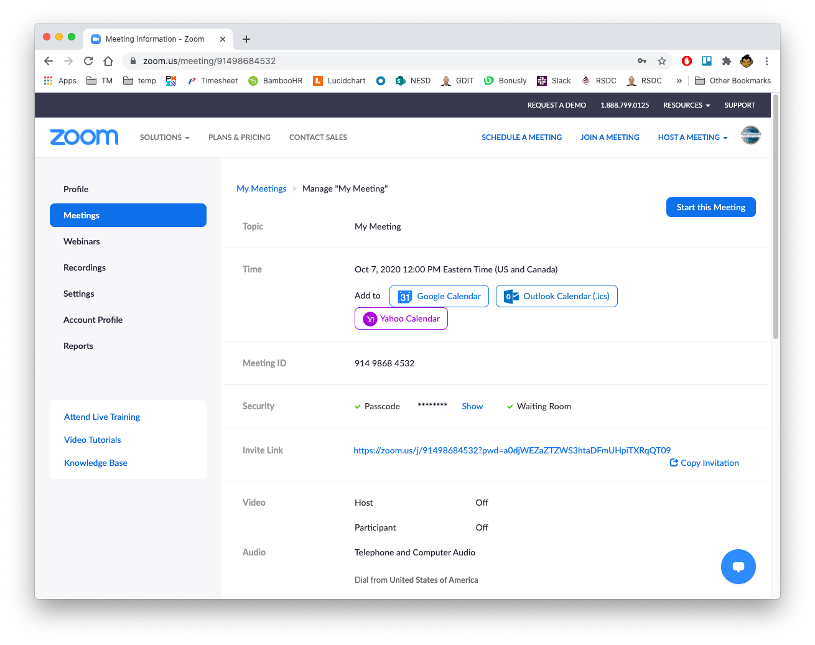
Copy Invitation

Slide 21
Edit a Meeting

Slide 22
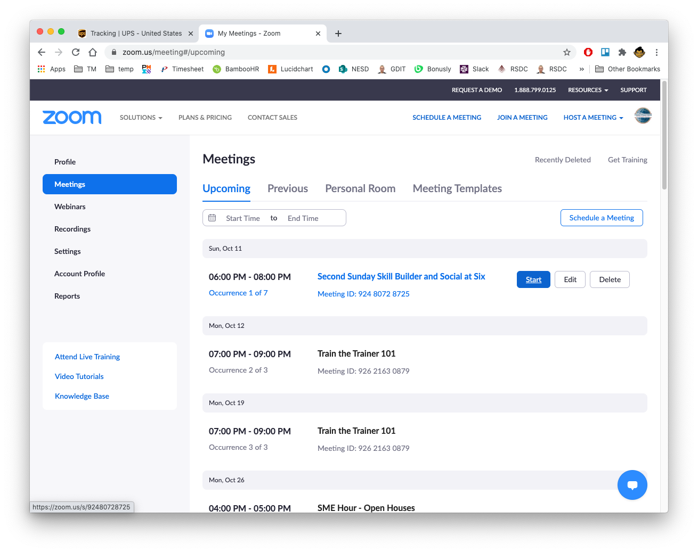
Start a Meeting

Slide 23
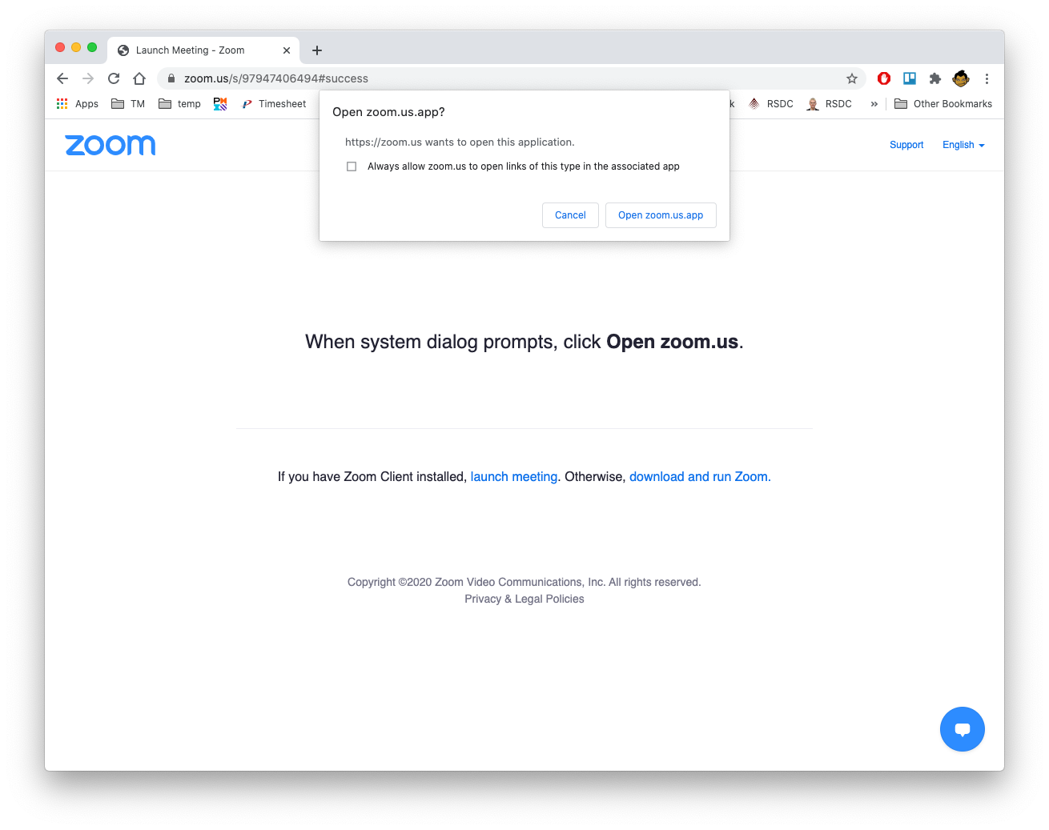
Start a Meeting

Slide 24
Agenda
Introduction
Zoom roles
Configure meeting settings
Schedule/Start a meeting
Manage meeting participants
Manage meetings
Breakout rooms
Questions

Slide 25
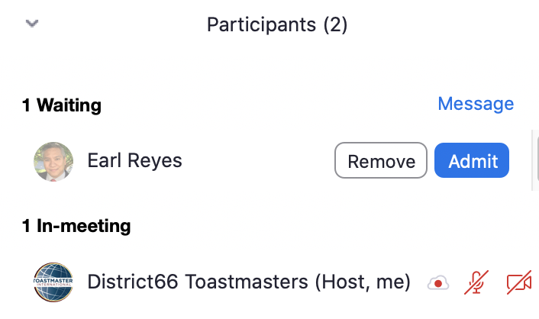
Admit Participants
Participant list
Admit
Admit

Slide 26
Mute/Stop Video/Rename/Remove Participants
Participant list
Mute
Stop Video
Rename
Remove

Slide 27
Agenda
Introduction
Zoom roles
Configure meeting settings
Schedule/Start a meeting
Manage meeting participants
Manage meetings
Breakout rooms
Questions

Slide 28
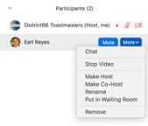
Make Host/Alternative Host/Co-Host
Participant list
Make Alternative-Host
Make Co-Host
Open participant list

Slide 29
Start/Stop Recording
Record
Meeting is recording

Slide 30
Recordings

Slide 31
Save Chat
Save Chat
\Documents\Zoom\date time meeting_name\meeting_saved_chat.txt

Slide 32
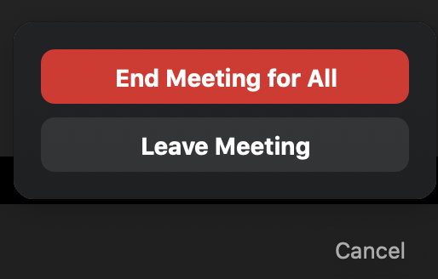
End Meeting
End
End Meeting for All

Slide 33
Agenda
Introduction
Zoom roles
Configure meeting settings
Schedule/Start a meeting
Manage meeting participants
Manage meetings
Breakout rooms
Questions

Slide 34
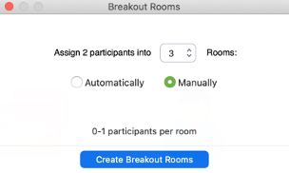
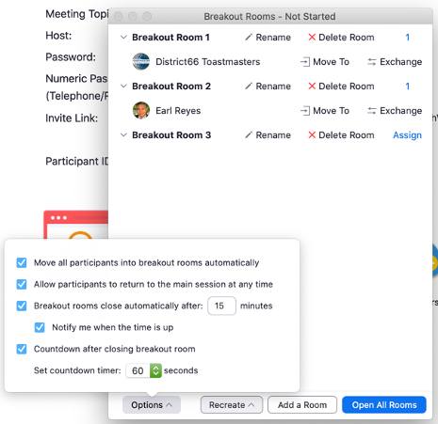
Create Breakout Rooms
Breakout Rooms
Number of Breakout Rooms
Automatically/ manually assign participants
Move participants automatically
Create Breakout Rooms
Close breakout rooms automatically
Countdown timer
Options

Slide 35
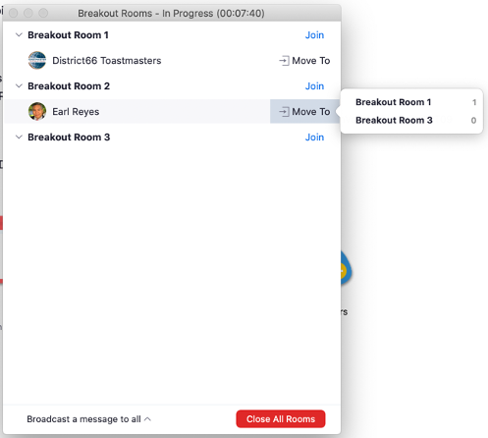
Assign Participants to Breakout Rooms
Assign participants
Rename Breakout Room
Delete Breakout Room
Re-assign participants
Add a Breakout Room

Slide 36
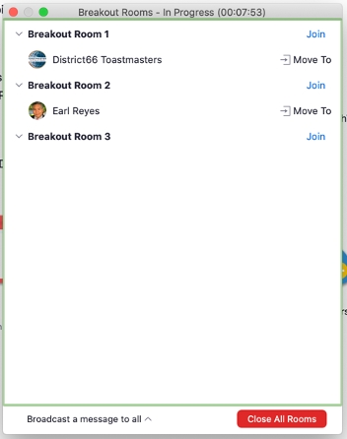
Open/Join/Close Breakout Rooms
Join Breakout Rooms
Open Breakout Rooms
Close Breakout Rooms

Slide 37
Broadcast Message to Breakout Rooms
Broadcast message
Compose broadcast message

Slide 38
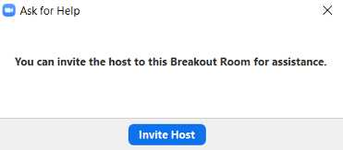
Asking For Help
Ask for help
Invite host

Slide 39
Questions?

Slide 40
Empower All Toastmasters
d66zoomteam@gmail.com

